Slide 1

Unity Legacy Image Effects Unity Tonemapping with Legacy Image Effects
jintaeks@dongseo.ac.kr
May 13, 2019

Slide 2
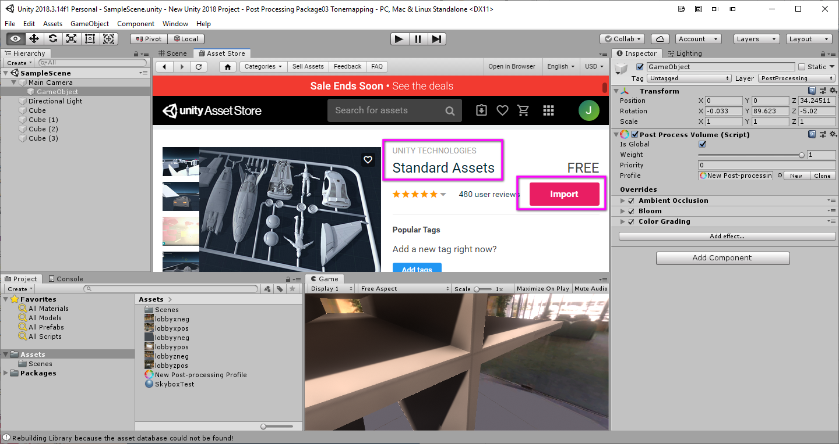
Notes:
if it does not work, Reimport all.

Slide 3
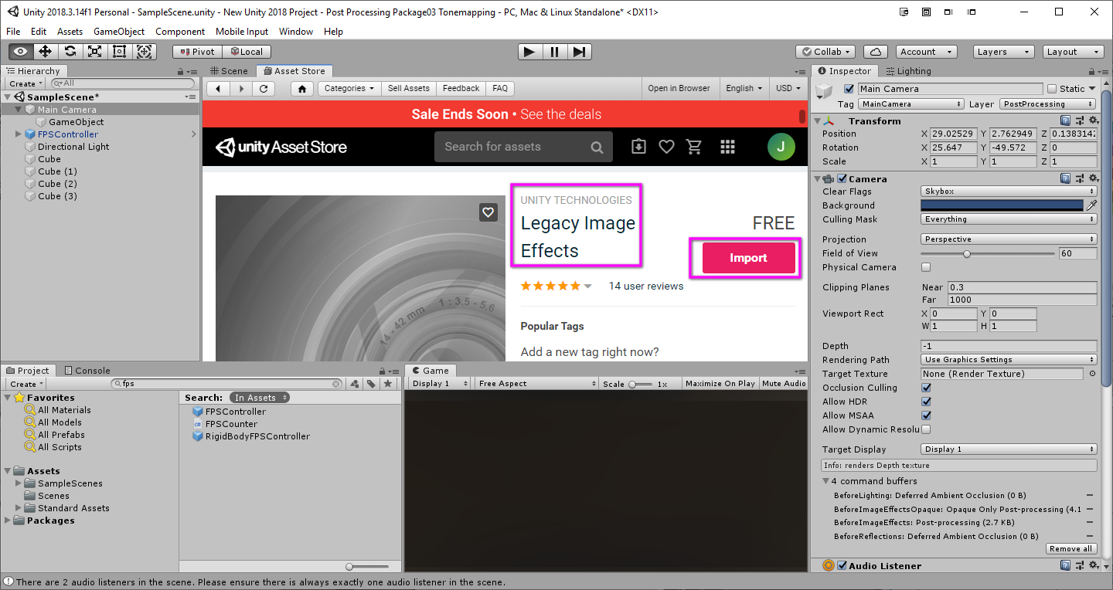

Slide 4
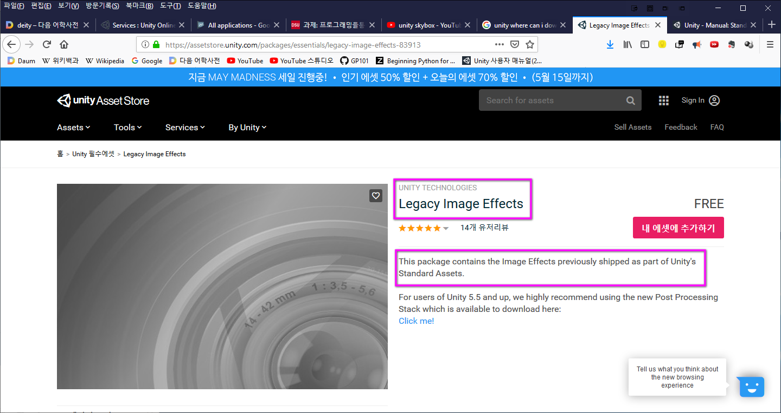

Slide 5
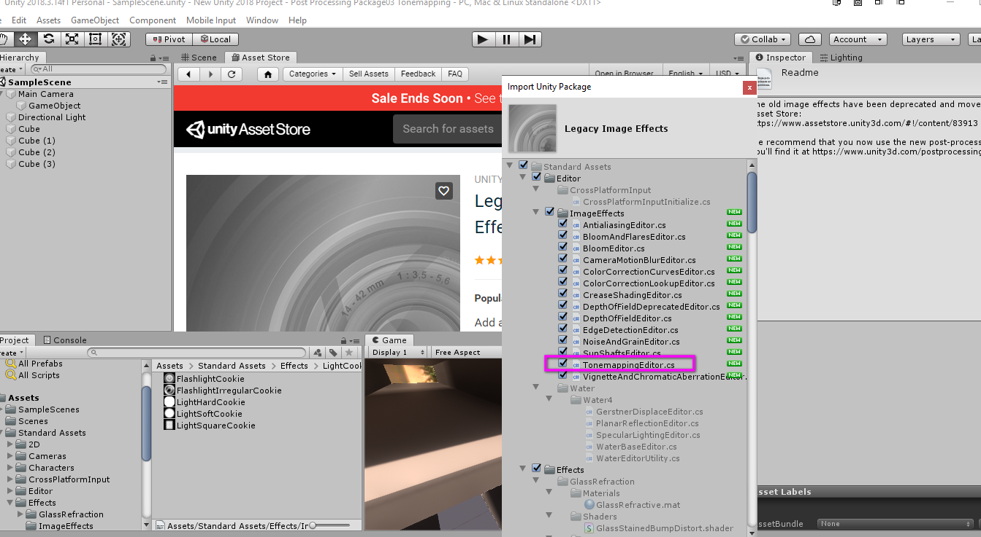

Slide 6
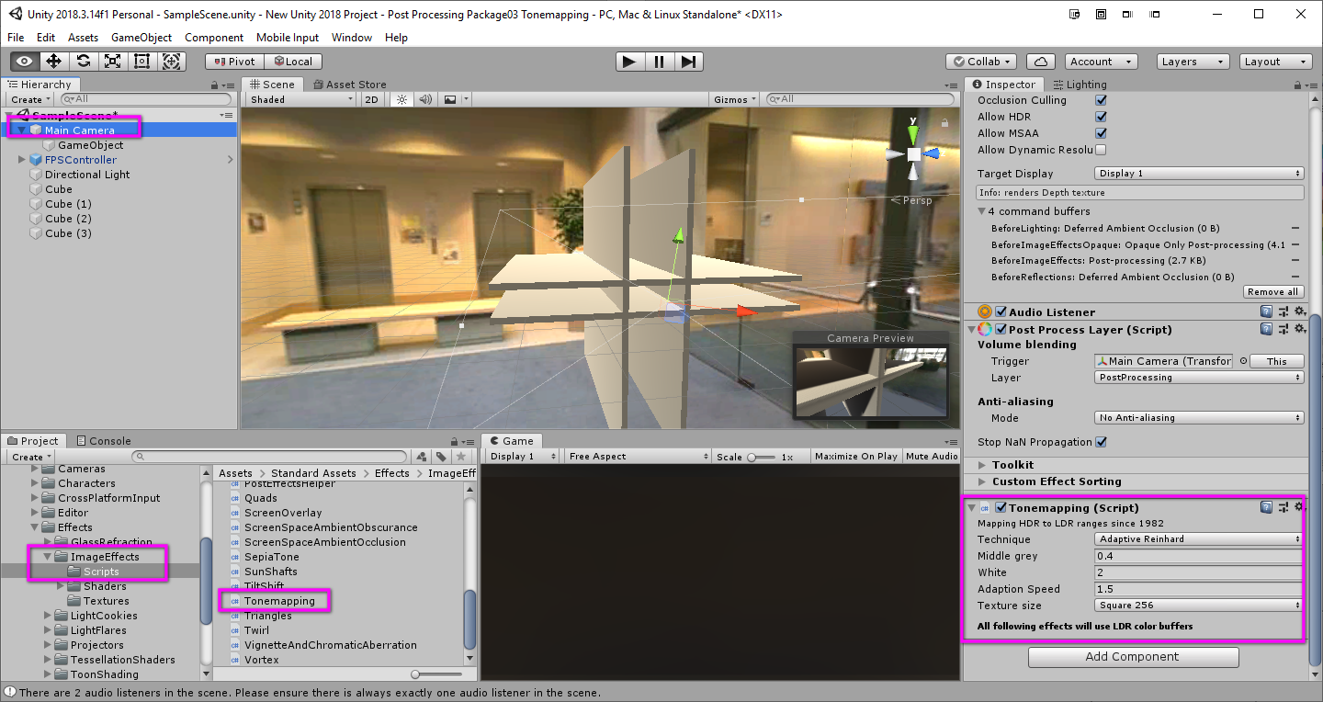

Slide 7

QnA

